Slide 1

Math’s 15
Differential Equations

Slide 2
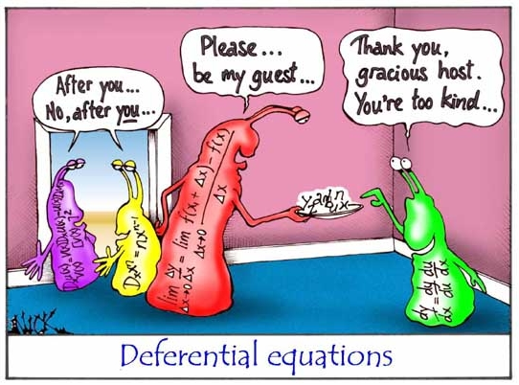
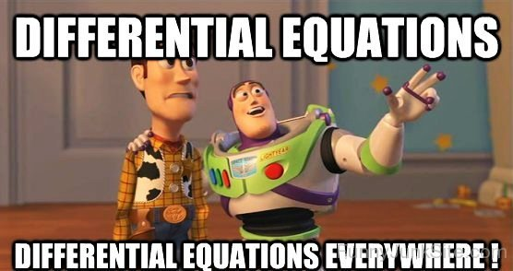
Differential Equations

Slide 3
Differential Equations
Congratulations you’ve reached the pinnacle : The differential equation.
In the simplest terms a differential equation is an equation the relates the original function to it’s own derivative.

Slide 4
Differential Equations
Usually you have a physical quantity like number of bacterial cells and you have the rate of change i.e birth and death rates.
A differential equation is what links those together.
Incredibly useful for understanding how things change through time.

Slide 5
Differential Equations
However differential equations are not so straightforward to solve.
There are numerous techniques that can be employed but the more complex the system the harder it is to solve them.

Slide 6
Differential Equations
However differential equations are not so straightforward to solve.
There are numerous techniques that can be employed but the more complex the system the harder it is to solve them.
Some complex systems require hugely powerful simulations just approximate an answer.

Slide 7
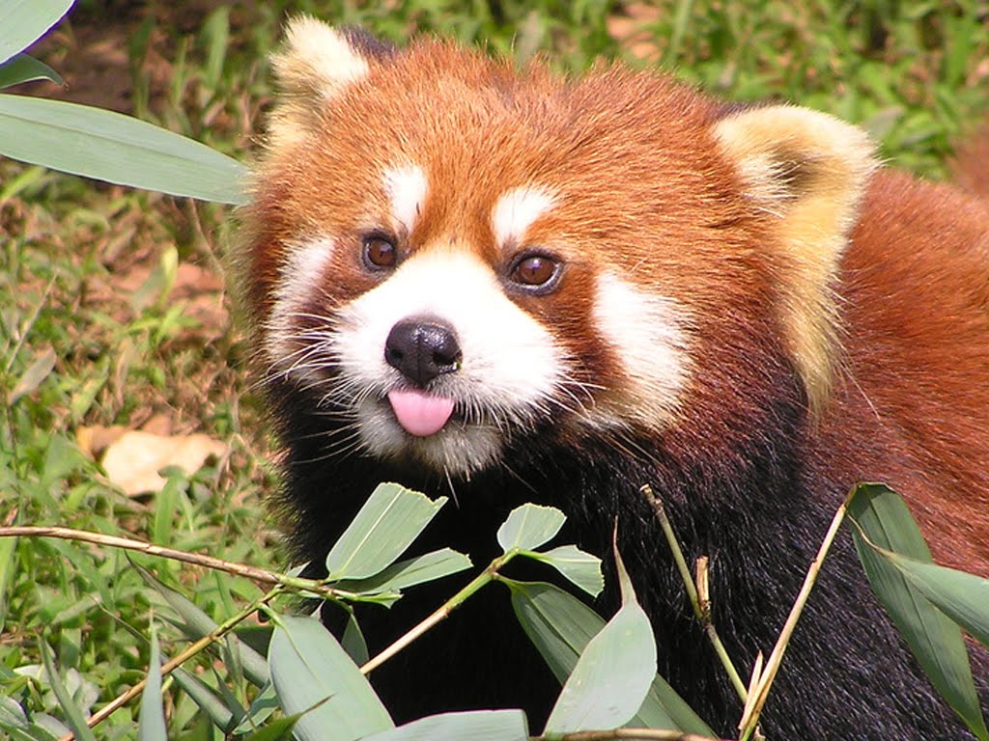
Differential Equations
Let’s take a look at a simple one:
I have a pest problem… My garden is filled with red pandas

Slide 8
Differential Equations
Let’s take a look at a simple one:
I have a pest problem… My garden is filled with red pandas
Look at that vicious bastard.

Slide 9
Differential Equations
Let’s take a look at a simple one:
Red pandas make baby red pandas.
Those baby red pandas grow up and
make more red pandas
The population grows in proportion
to the population size.

Slide 10
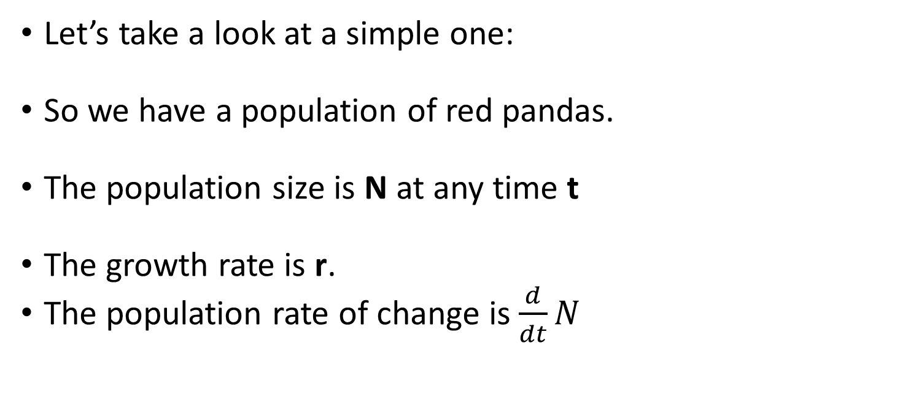
Differential Equations
Let’s take a look at a simple one:
So we have a population of red pandas.
The population size is N at any time t
The growth rate is r.
The population rate of change is $\frac{d}{dt}N$

Slide 11
Differential Equations
Let’s take a look at a simple one:
So we have a population of red pandas. Lets put some real number in.
If there are 100 red pandas in my
garden.
And they grow by 0.01 pandas per panda.

Slide 12
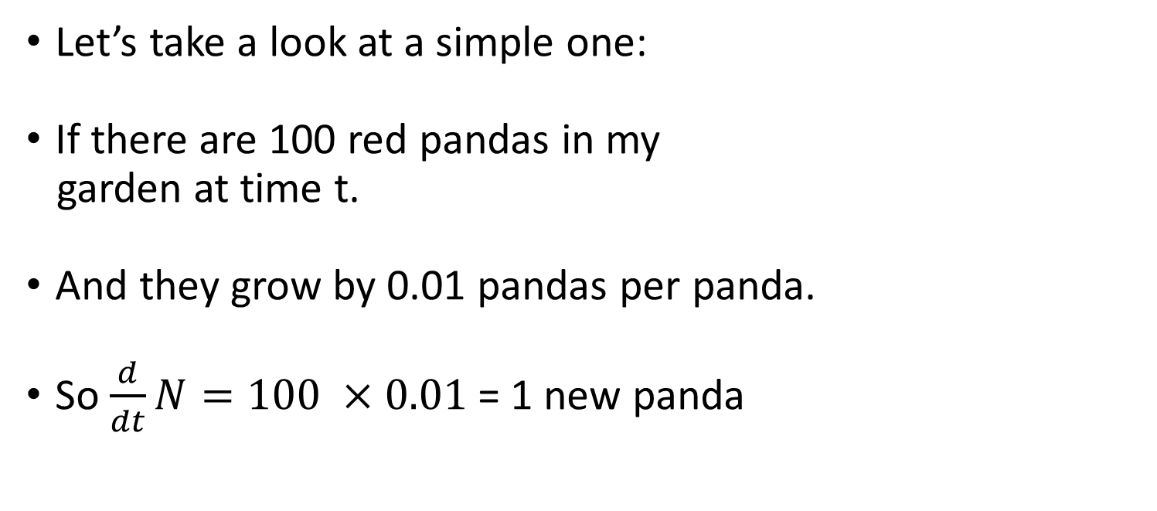
Differential Equations
Let’s take a look at a simple one:
If there are 100 red pandas in my
garden at time t.
And they grow by 0.01 pandas per panda.
So $\frac{d}{dt}N=100 ×0.01$= 1 new panda

Slide 13
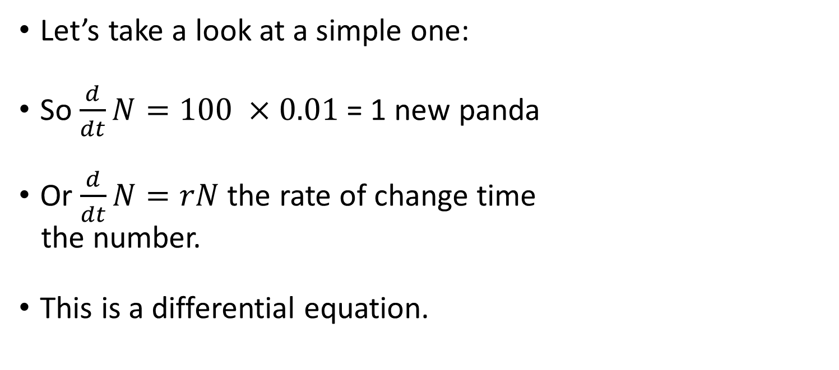
Differential Equations
Let’s take a look at a simple one:
So $\frac{d}{dt}N=100 ×0.01$= 1 new panda
Or $\frac{d}{dt}N=rN$ the rate of change time
the number.
This is a differential equation.

Slide 14
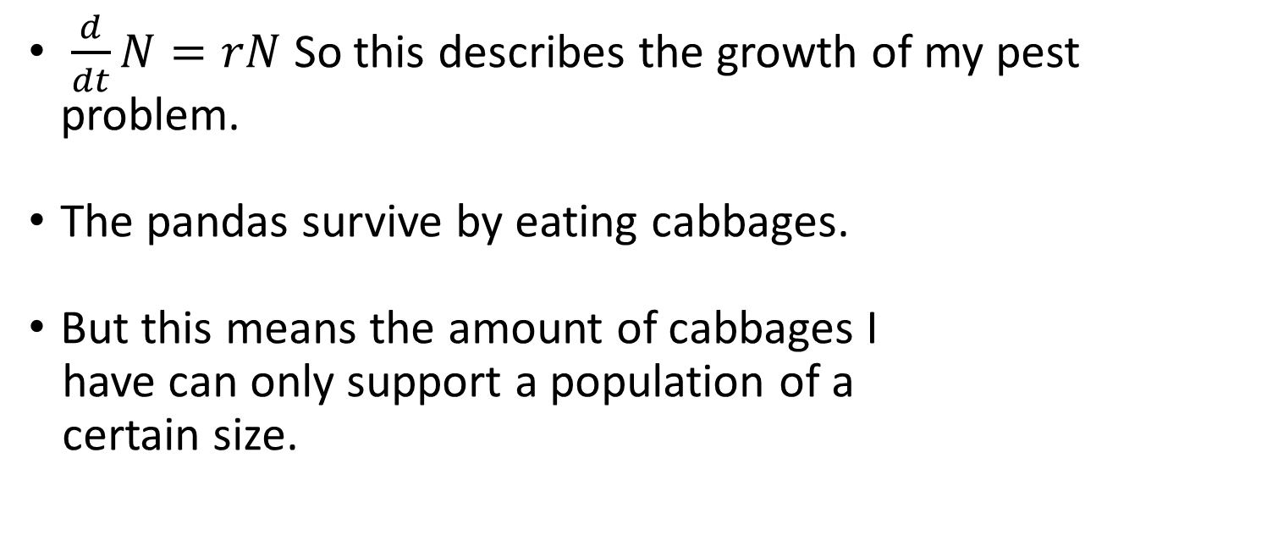
Differential Equations
$\frac{d}{dt}N=rN$ So this describes the growth of my pest problem.
The pandas survive by eating cabbages.
But this means the amount of cabbages I
have can only support a population of a
certain size.

Slide 15
Differential Equations
$\frac{d}{dt}N=rN$ So this describes the growth of my pest problem.
The pandas survive by eating cabbages.
But this means the amount of cabbages I
have can only support a population of a
certain size.

Slide 16
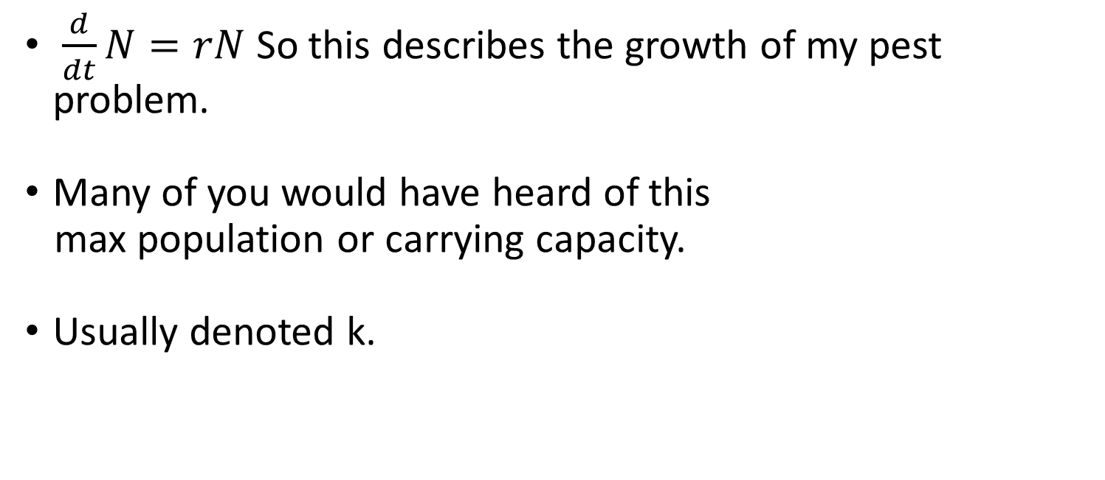
Differential Equations
$\frac{d}{dt}N=rN$ So this describes the growth of my pest problem.
Many of you would have heard of this
max population or carrying capacity.
Usually denoted k.

Slide 17
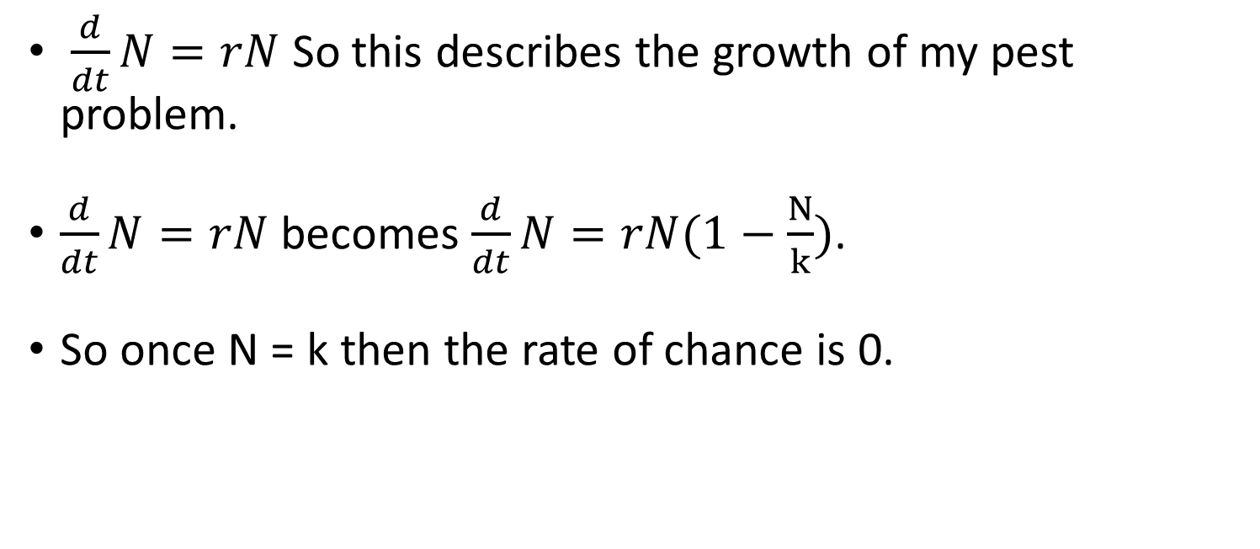
Differential Equations
$\frac{d}{dt}N=rN$ So this describes the growth of my pest problem.
$\frac{d}{dt}N=rN$ becomes $\frac{d}{dt}N=rN(1−\frac{N}{k})$.
So once N = k then the rate of chance is 0.

Slide 18
Differential Equations
Differential equations can be extremely complex including numerous variables.
What if I harvested my cabbages once a year? How would that effect population size?
What if I killed x amount each week trying to control them?
Etc etc….

Slide 19
Differential Equations
The whole purpose of differential equations is solving them! So we can know what the value will be at any time point, or when they will be optimised, or just how they will change etc..
But before we can solve one we need to classify it.
The way we solve it varies on the type.

Slide 20
Differential Equations
There are two different types of differential equation. Ordinary and Partial.
Ordinary differential equations (ODEs) have only one variable.
Partial Differential equations (PDEs) have more than one variable (like our partial derivatives).

Slide 21
An ode to ODEs
Here we will focus on ordinary differential equations.
The important things to look at once you know it is an ODE are called the order and the degree.
The order is the highest order derivative within the differential equation.
The degree is the highest exponent of the highest derivative.

Slide 22
An ode to ODEs
Here we will focus on ordinary differential equations.
The important things to look at once you know it is an ODE are called the order and the degree.
The order is the highest order derivative within the differential equation.
The degree is the highest exponent of the highest derivative.

Slide 23
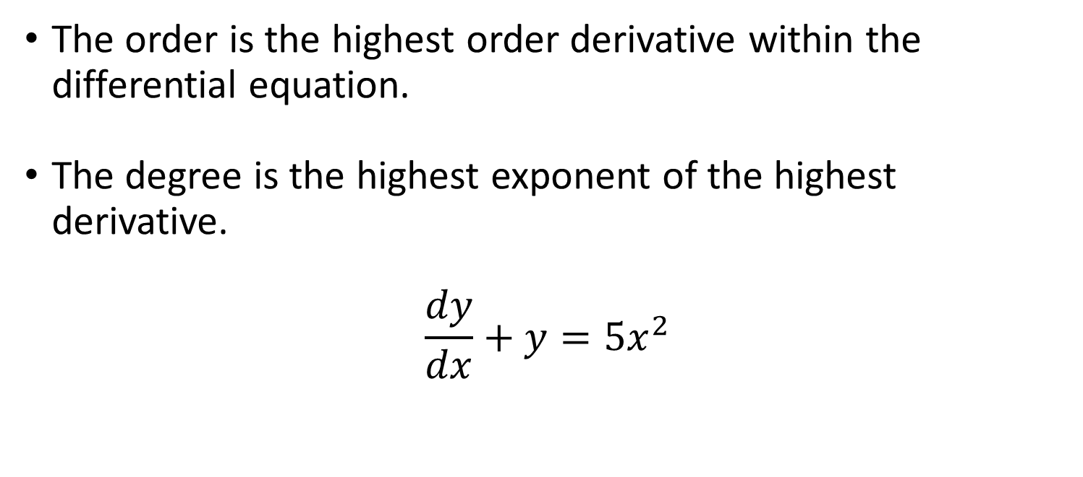
An ode to ODEs
The order is the highest order derivative within the differential equation.
The degree is the highest exponent of the highest derivative.
$$\frac{dy}{dx}+y=5x^{2}$$

Slide 24
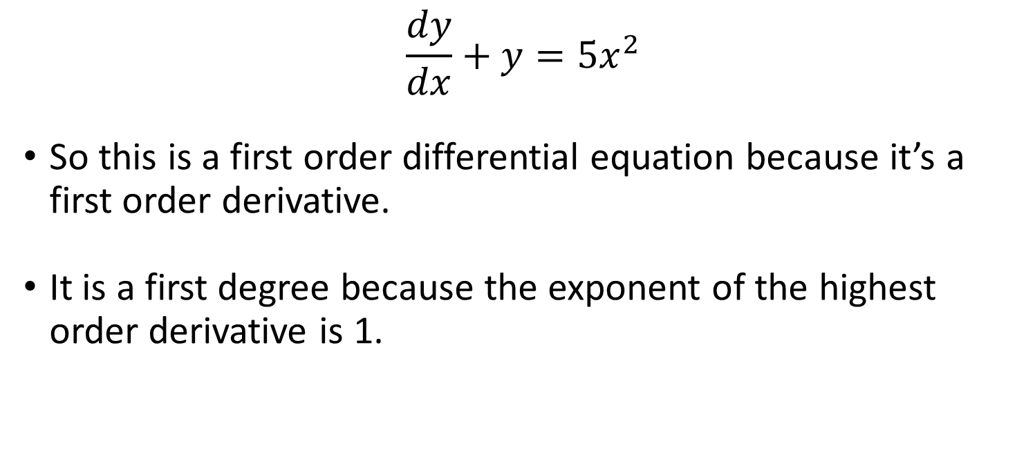
An ode to ODEs
$$\frac{dy}{dx}+y=5x^{2}$$
So this is a first order differential equation because it’s a first order derivative.
It is a first degree because the exponent of the highest order derivative is 1.

Slide 25
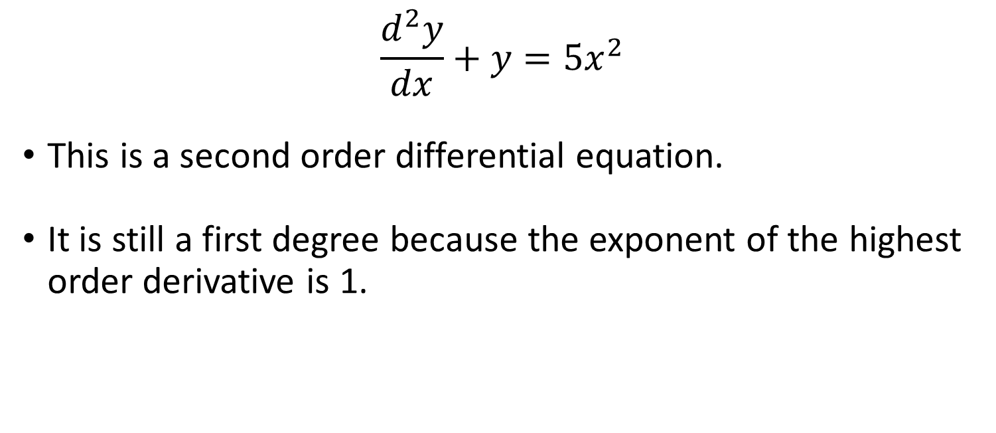
An ode to ODEs
$$\frac{d^{2}y}{dx}+y=5x^{2}$$
This is a second order differential equation.
It is still a first degree because the exponent of the highest order derivative is 1.

Slide 26
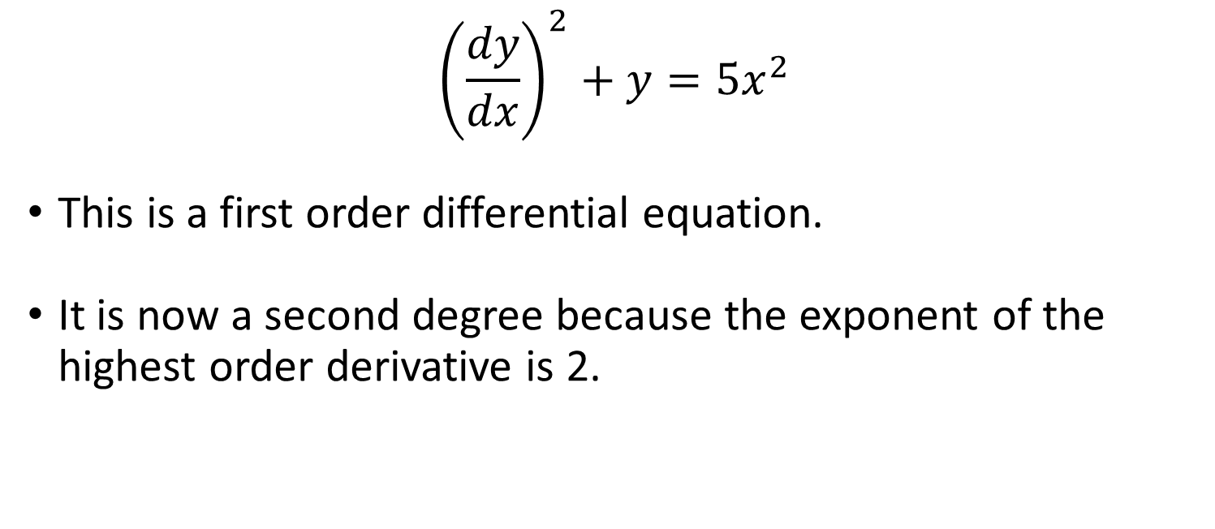
An ode to ODEs
$${\left(\frac{dy}{dx}\right)}^{2}+y=5x^{2}$$
This is a first order differential equation.
It is now a second degree because the exponent of the highest order derivative is 2.

Slide 27
An ode to ODEs
Differential equations have two forms of solutions. General and particular.
A general solution is the solution for the equation that works for all the equation.
The particular solution is the solution for a specific part of the equation. You use the general solution to find it.

Slide 28
An ode to ODEs
Differential equations have two forms of solutions. General and particular.
A general solution is the solution for the equation that works for all the equation.
The particular solution is the solution for a specific part of the equation. You use the general solution to find it.

Slide 29
An ode to ODEs
This is similar to definite and indefinite integrals.
The general is the indefinite while the particular is the definite.

